Slide 1

Go, change the world
RV College of
Engineering
Elements of Industry 4.0
Category: Emerging Technologies
(ME114BT / ME124BT)
Presented by
Department of Mechanical Engineering,
RV College of Engineering
Bangaluru-560059

Slide 2
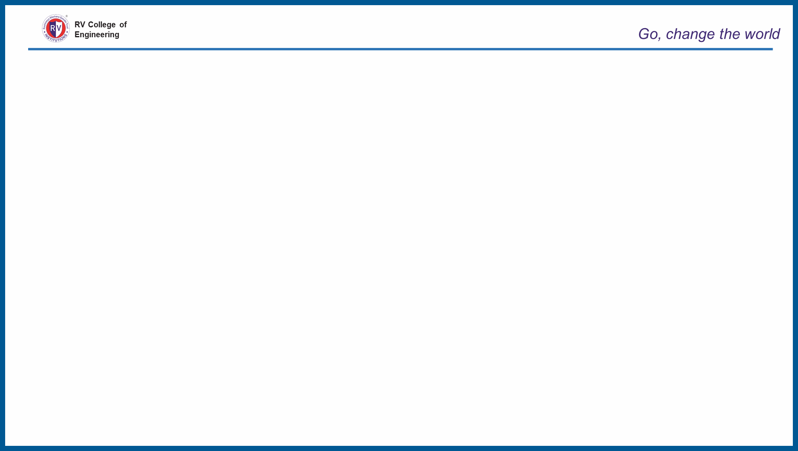
INTRODOCTION TO SYLLABUS
Course Title: ELEMENTS OF INDUSTRY 4.0 | Course Code: ME114BT / ME124BT
Total Contact Hours: 42L | Duration of SEE: 3 Hrs.
SEE Marks: 100 | CIE Marks: 100
Course In-charge: Dr. Chandrakumar R, Prof. Keshavamurthy Y C | Category: Emerging Technology
Credits: 3:0:0 | Academic Year: 2022-23

Slide 3
INTRODOCTION TO SYLLABUS
UNIT- I (06 hours)
Industry 4.0 - Introduction
The Various Industrial Revolutions, Need – Reason for Adopting Industry 4.0, Definition, Goals and Design Principles – Interoperability, Virtualization, Decentralization, Real-time Capability, Road to Industry 4.0 – Industrial Internet of Things (IIoT).

Slide 4
INTRODOCTION TO SYLLABUS
UNIT- II (10 hours)
Opportunities and Challenges : Lack of resources, Availability of skilled workers, Broadband infrastructure, Policies, Future of Works and Skills in the Industry 4.0 Era
Horizontal and Vertical Integration :End-to-end engineering of the overall value chain, Digital integration platforms, Role of machine sensors, Sensing classification according to measuring variables, Machine-to-Machine communication.

Slide 5
INTRODOCTION TO SYLLABUS
UNIT-III (10 hours)
Smart Worker, Augmented and Virtual Reality, Industrial Applications – Maintenance, Assembly, Collaborative operations, Training
Digital-to-Physical, Additive Manufacturing technologies, Advantages, impact on environment, Applications – Automotive, Aerospace, Electronics, Medical.

Slide 6
INTRODOCTION TO SYLLABUS
UNIT-IV (08 hours)
Digital Twin, Virtual factory, Total Productive Maintenance, Understanding I 4.0 in MSMEs, Industry 5.0
Cloud Computing
Fundamentals, Cloud / Edge Computing and Industry 4.0, The IT/OT convergence, Cyber Security.

Slide 7
INTRODOCTION TO SYLLABUS
Unit- V (08 hours)
Artificial Intelligence
Fundamentals, Case Studies, Technology paradigms in production logistics - Intelligent conveyor system, Intelligent commissioning system, Intelligent production machine, Intelligent load carrier, Applications
Intelligent Objects (user-oriented functions), Technological realization of Intelligent Objects (product-oriented functions).

Slide 8
INTRODOCTION TO SYLLABUS
COURSE OUTCOME:
After going through this course, the student will be able to:
Get acquainted with concept of industry 4.O, It’s evolution and its components
Requirements of I4.O, modern tools and software requirements for the implementation of I4.O,
Understand the concept of digital twin, modern manufacturing, cloud computing, Artificial intelligence etc.

Slide 9
INTRODOCTION TO SYLLABUS
CO1 | Identify the basic components of Industry 4.0.
CO2 | Analyze the role of digital twin and cloud for modern manufacturing.
CO3 | Create smart and digital models for industrial scenario.
CO4 | Understand Artificial intelligence models for modern manufacturing.

Slide 10
INTRODOCTION TO SYLLABUS
Reference Books
1 | Industry 4.0: Managing The Digital Transformation, Alp Ustundag, Emre Cevikcan, 2017, Springer, ISBN 978-3-319-57869-9 ISBN 978-3-319-57870-5.
2 | The Concept Industry 4.0 - An Empirical Analysis of Technologies and Applications in Production Logistics, Christoph Jan Bartodziej, 2017, Springer Gabler, ISBN 978-3-658-16501-7 ISBN 978-3-658-16502-4.
3 | Industry 4.0 - The Industrial Internet of Things, Alasdair Gilchrist, 2016, APRESS, ISBN-13 978-1-4842-2046-7 ISBN-13 978-1-4842-2047-4.
4 | Digitizing the Industry – Internet of Things connecting the Physical, Digital and Virtual Worlds, Ovidiu Vermesan, 2016, River Publishers, ISBN 978-87-93379-81-7 ISBN 978-87-93379-82-4.

Slide 11
INTRODOCTION TO SYLLABUS
Scheme of Continuous Internal Evaluation: Theory 100 Marks
Quiz-1 | 10
Test-1 | 50
Quiz-2 | 10
Test-2 | 50
Each test will be conducted for 50 Marks adding to 100 marks. Final test marks will be reduced to 40
Each quiz will be conducted for 10 Marks adding to 20 marks
Experimental Learning | 40
Final Evaluation | Quiz 10+10 =20 Test 50+50 =100 reduced to 40 Experimental Learning =40 GRAND TOTAL: 100

Slide 12
INTRODOCTION TO SYLLABUS
Semester End Evaluation (Theory)
PART-A Objective type Questions | 20
PART-B The UNIT-1 The UNIT-2 The UNIT-3 The UNIT-4 The UNIT-5 All the questions should be of the same complexity in terms of CO’s and Bloom’s taxonomy level. | 80
Total | 100

Slide 13


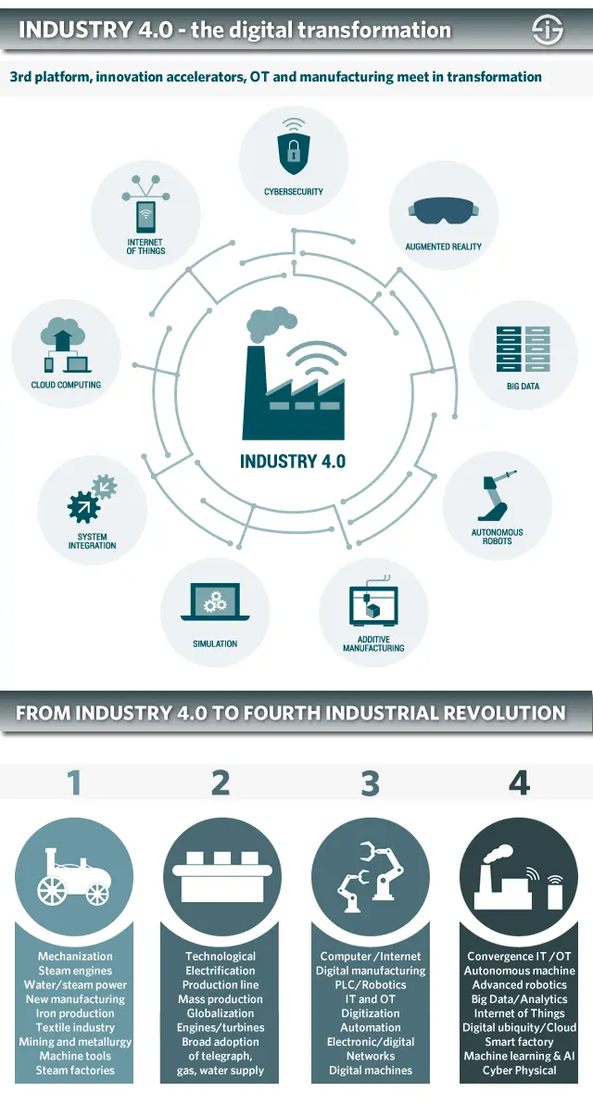
RV College of
Engineering
Industry 4.0 and the fourth industrial revolution (4IR)
The first industrial revolution, which REALLY was a revolution, and, among others thanks to invention of steam machines, the usage of water and steam power and all sorts of other machines, would lead to the industrial transformation of society with trains, mechanization of manufacturing and loads of smog. The first industrial revolution spanned from about 1760 to around 1840. Triggered by the construction of railroads and the invention of the steam engine, it ushered in mechanical production.
Department of Mechanical Engineering, RV College of Engineering, Bangalore-560059

Slide 14
RV College of
Engineering
Industry 4.0 and the fourth industrial revolution (4IR)
The second industrial revolution is typically seen as the period where electricity and new manufacturing ‘inventions’ which it enabled, such as the assembly line, led to the area of mass production and to some extent to automation. The second industrial revolution, which started in the late 19th century and into the early 20th century, made mass production possible, fostered by the advent of electricity and the assembly line.
Department of Mechanical Engineering, RV College of Engineering, Bangalore-560059

Slide 15
RV College of
Engineering
Industry 4.0 and the fourth industrial revolution (4IR)
The third industrial revolution had everything to do with the rise of computers, computer networks (WAN, LAN, MAN,…), the rise of robotics in manufacturing, connectivity and obviously the birth of the Internet, that big game changer in the ways information is handled and shared, and the evolutions to e-anything versions of previously brick and mortar environments only, with far more automation. The third industrial revolution began in the 1960s. It is usually called the computer or digital revolution because it was catalyzed by the development of semiconductors, mainframe computing (1960s), personal computing (1970s and ‘80s and the internet (1990s).
Department of Mechanical Engineering, RV College of Engineering, Bangalore-560059

Slide 16
RV College of
Engineering
Industry 4.0 and the fourth industrial revolution (4IR)
In the fourth industrial revolution we move from ‘just’ the Internet and the client-server model to ubiquitous mobility, the bridging of digital and physical environments (in manufacturing referred to as Cyber Physical Systems), the convergence of IT and OT, and all the previously mentioned technologies (Internet of Things, Big Data, cloud, etc.) with additional accelerators such as advanced robotics and AI/cognitive which enable Industry 4.0 with automation and optimization in entirely new ways that lead to ample opportunities to innovate and truly fully automate and bring the industry to the next level.
Department of Mechanical Engineering, RV College of Engineering, Bangalore-560059

Slide 17
RV College of
Engineering
Industry 4.0
• Industry 4.0 is a name given to the current trend of automation and data exchange in manufacturing technologies.
• Industry 4.0 is the cyber-physical transformation of manufacturing.
• It includes cyber-physical systems, the Internet of things, cloud computing and cognitive computing.
• Industry 4.0 is commonly referred as the fourth industrial revolution
Department of Mechanical Engineering, RV College of Engineering, Bangalore-560059

Slide 18
RV College of
Engineering
Industry 4.0 and the fourth industrial revolution (4IR)
Products and manufacturing processes are networked to communicate to enable the industry 4.0 technologies to create value and optimize in real-time. Cyber-physical systems are the source that makes capabilities for modern smart factories, which includes remote tracking, monitoring, etc.
Interchangeably used with the fourth worldwide industrial revolution, industry 4.0 represents another stage in the organization and controls the on-ground value chain. Its characteristics include:
More automation compared to the third revolution
Bridging gaps between the digital and physical world through cyber-physical systems introduced by IIoT
A significant shift from the central industrial control to a place where the latest intelligent products define the steps of production
Closed-loop control systems and data models
Product customization/personalization
Department of Mechanical Engineering, RV College of Engineering, Bangalore-560059

Slide 19
RV College of
Engineering
Why is Industry 4.0 Needed?
Business belongs to a competitive industry with many tech-savvy rivals
Facing difficulties recruiting resources at your organization
Expect greater visibility across the supply chain
You must identify minor issues before they turn into more significant problems and address them
You are eager to boost profitability and efficiency across the organization
You want the entire organization to be informed and stay updated with a relevant view of business processes and production
You want timely and rich analytics
You require help to digitize and make the information relevant
You aspire to improve overall customer satisfaction and experience
You want to scale up the quality of your product and maintain it
You want to create an integrated ERP system spanning across inventory as well as planning, financials, supply chain management, manufacturing execution, and customer relationships
You expect a flexible and consistent view of business operations and production tailored to exact areas
You are looking for real-time insights to feel better and make faster business decisions each day
Department of Mechanical Engineering, RV College of Engineering, Bangalore-560059

Slide 20
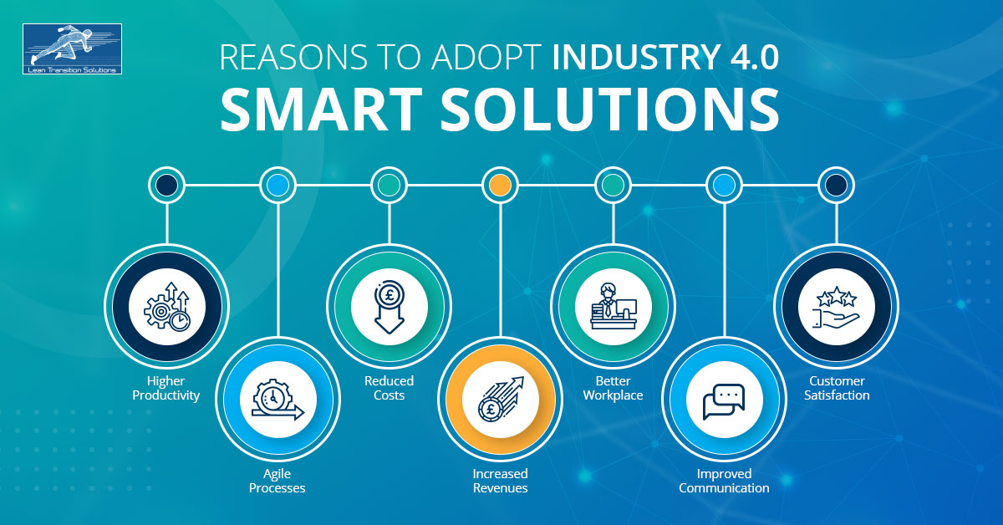
RV College of
Engineering
Reasons to Adopt Industry 4.0
Department of Mechanical Engineering, RV College of Engineering, Bangalore-560059

Slide 21
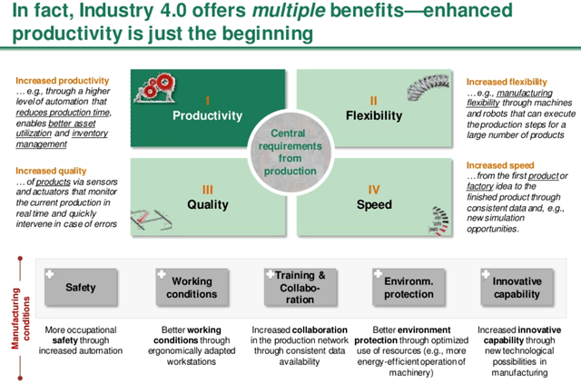
RV College of
Engineering
Reasons to Adopt Industry 4.0
Department of Mechanical Engineering, RV College of Engineering, Bangalore-560059

Slide 22
RV College of
Engineering
Reasons to Adopt Industry 4.0
Higher Productivity: Industry 4.0 help organisations do more with less. Allocate resources efficiently, increase production, reduce waste, improve customer satisfaction, save time and cost. Ensure greater efficiency with faster decision making.
Agile Processes: Increase business processes in a volatile environment by enhancing the resilience of the organisation—flexible and scalable Industry 4.0 integrated system to effectively manage change and uncertainties in processes.
Reduced Costs: Move to automated processes, increase efficiency—lower operating costs and reduce waste in manufacturing through better utilisation of resources. Higher automation saves labour costs and improves output. Automatically optimise resources for minimum wastage.
Increased Revenues: Industry 4.0 ensures higher ROI. Produce high-quality products, increase customer satisfaction—staunch a stable position in the marketplace. Implementation of automation, data management, systems integration, and artificial intelligence will increase the profitability of your business.
Department of Mechanical Engineering, RV College of Engineering, Bangalore-560059

Slide 23
RV College of
Engineering
Reasons to Adopt Industry 4.0
Better workplace: Incorporating new technologies into business ensures a better and smart workplace. The combination of automated solutions and human labour directs to more fulfilling roles that result in the development of an organisation.
Improved Communication: Gather real-time data analysis and meaningful insights. Detailed data is collected, stored, analysed and shared across departments to ensure transparent communication. From production planning to execution, every step of the process is communicated across the departments, which promotes a connected work environment.
Customer Satisfaction: Customer is the king! Meet customer expectations and demands. Provide quality products to customers at low cost and great availability. Address issues and ensure excellent customer service. Make them fall in love with your products.
Department of Mechanical Engineering, RV College of Engineering, Bangalore-560059

Slide 24
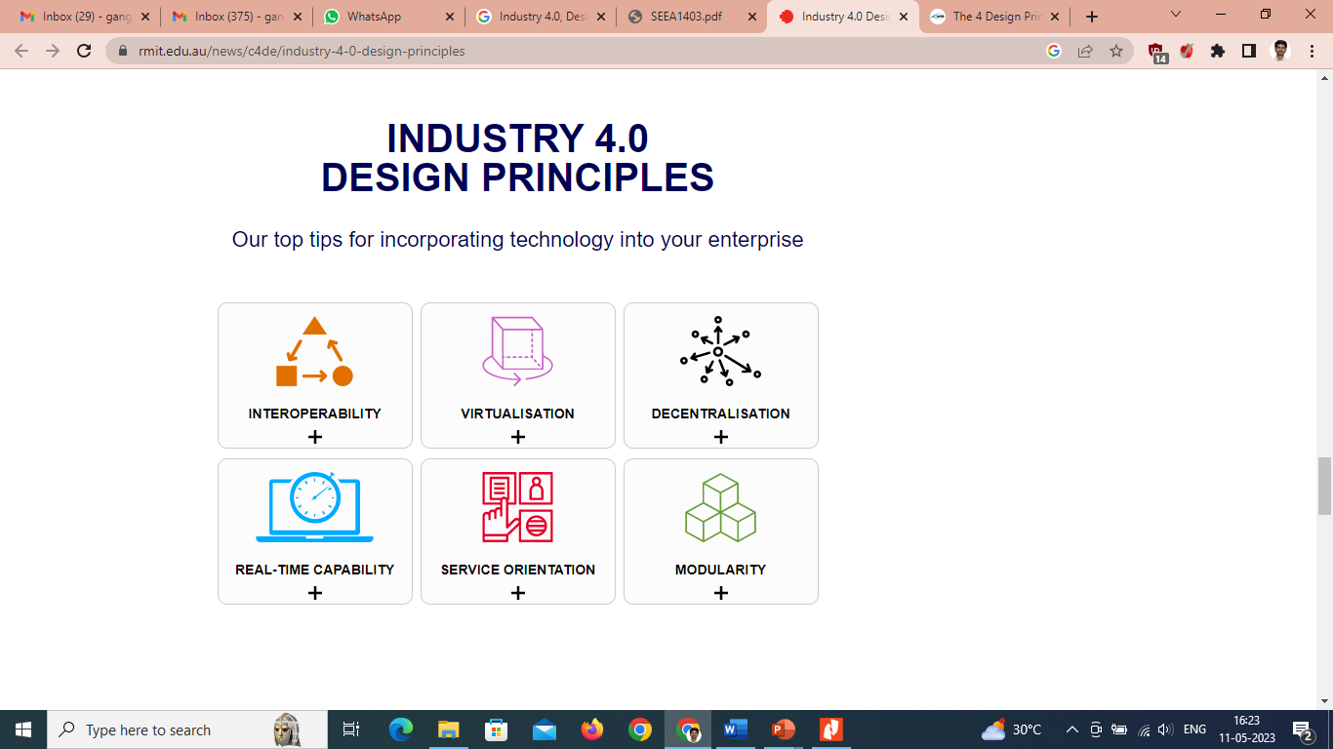
RV College of
Engineering
Design Principles of Industry 4.0
The ability of objects, machines and people in your business to communicate, exchange data and coordinate activities.
The ability to create a virtualised view of your operations or virtual copies of everything to see how new equipment or processes will impact operations.
Business logic (the programming that manages the communication between a database and the end user interface) that is contained in sub-systems or components rather than a central computer system, enabling cyber-physical systems to make autonomous decisions.
The collection and analysis of data in real-time, allowing decisions to be made immediately and at every moment.
Free information flow within and between businesses to better meet customer needs.
The ability to flexibly adapt to changing requirements and industry needs.
Department of Mechanical Engineering, RV College of Engineering, Bangalore-560059

Slide 25
RV College of
Engineering
Design Principles of Industry 4.0
Interoperability
This first principle is Interoperability. This is the ability of machines, devices, sensors, and people to connect and communicate with each other via the Internet of Things (IoT) and then make use of that information to function and execute improvements. The first step is to connect your Smart Tools, sensors, machines, and workers together to create advanced data collection resources. With this, you gain widespread visibility into your operation and capture in-depth and accurate knowledge.
The next step within interoperability is to integrate this data with your LMS, MES, ERP, or other smart factory solution and analyze the data in real-time. This creates a network of interconnected data-generating points that can be accessed anytime anywhere. This principle dwells on the technology's ability to provide enhanced information for future decision-making.
The interoperability of Industry 4.0 not only gives manufacturers access to vast amounts of data and accurate operational knowledge, but it also gives it to them at blazing speeds, even down to the second.
Department of Mechanical Engineering, RV College of Engineering, Bangalore-560059

Slide 26
RV College of
Engineering
Design Principles of Industry 4.0
Information Transparency
Transparency in this context is used to describe how easy it is to observe the actions taken and the information being stored. With this in mind, Information Transparency is an essential design principle of Industry 4.0 because the information is crystal clear and easy to access, providing a fast and powerful method to extrapolate knowledge.
In other words, embracing this industry 4.0 design principle helps you monitor processes on the shop floor and allows management to instantly adjust and optimize for higher efficiency. The more information that is being collected, the greater visibility you gain into your operation, and the greater the ability you have to make effective and long-lasting improvements. Essentially, we don’t want this information hidden from the people who need it the most. It needs to be transparent.
Department of Mechanical Engineering, RV College of Engineering, Bangalore-560059

Slide 27
RV College of
Engineering
Design Principles of Industry 4.0
Technical Assistance
Firstly, technical assistance is the ability of cyber-physical systems to support humans by aggregating and visualizing information comprehensibly so that making informed decisions and solving urgent problems on short notice is simple and effective. Work instruction software is a prime example of Technical Assistance being used to support people with visually interactive procedural guides.
Secondly, technical assistance is also the ability of cyber-physical systems to physically support humans by conducting a range of tasks that are unpleasant, too exhausting, or unsafe for their human co-workers. Think about robots within factories now and how they decrease workplace-related injuries.
Technical assistance is helping manufacturers understand their data in faster and more powerful ways while taking on the more arduous and dangerous tasks on the shop floor.
Department of Mechanical Engineering, RV College of Engineering, Bangalore-560059

Slide 28
RV College of
Engineering
Design Principles of Industry 4.0
Decentralization of Decisions
The decentralization of decisions stems from the ability of cyber-physical systems to make choices independent of people. Instead of requiring workers to painstakingly watch for variances or oversee material needs, the cyber-physical system will manage these issues autonomously through a decentralized network of IoT and cloud computing.
Naturally, this leads to machines and systems that can take action and perform their tasks with little to no human intervention, making factors like problem-solving, calibration, adjustments, and notifications a fast and autonomous system. Only in the case of exceptions, interferences, or conflicting goals are tasks delegated to a higher level. A decentralized system is also highly adaptable and scalable which determines how efficiently you can respond to industry changes.
Department of Mechanical Engineering, RV College of Engineering, Bangalore-560059

Slide 29
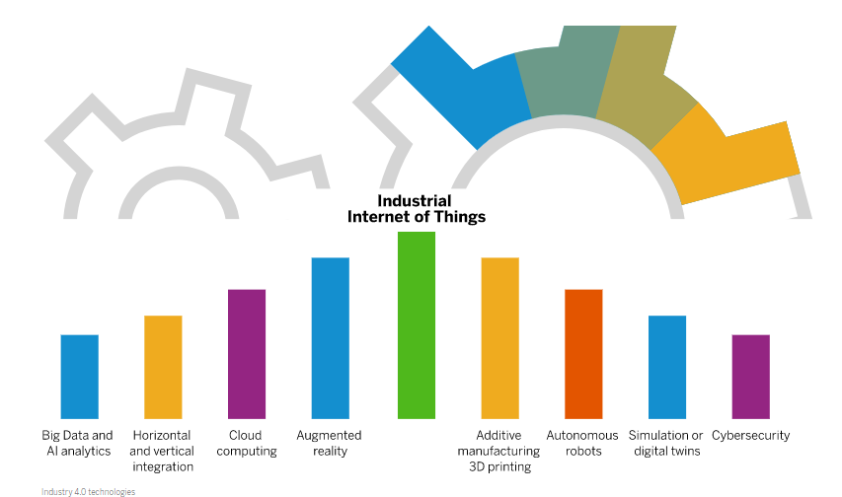
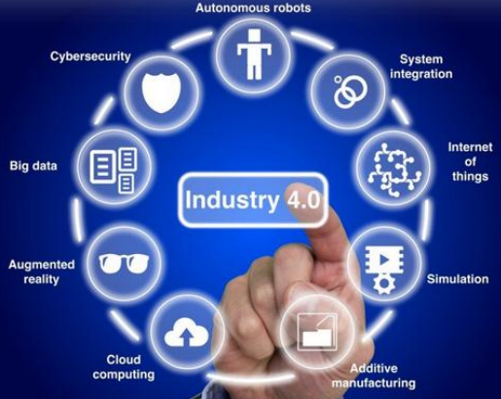
RV College of
Engineering
Industry 4.0 technologies/ Pillars
Industry 4.0 is built on nine technology pillars. These innovations bridge the physical and digital worlds and make smart and autonomous systems possible. Businesses and supply chains already use some of these advanced technologies, but the full potential of Industry 4.0 comes to life when they’re used together.
Department of Mechanical Engineering, RV College of Engineering, Bangalore-560059

Slide 30
RV College of
Engineering
Industry 4.0 technologies/ Pillars
Big Data and AI analytics: In Industry 4.0, Big Data is collected from a wide range of sources, from factory equipment and Internet of Things (IoT) devices, to ERP and CRM systems, to weather and traffic apps. Analytics powered by artificial intelligence (AI) and machine learning are applied to the data in real time – and insights are leveraged to improve decision-making and automation in every area of supply chain management: supply chain planning, logistics management, manufacturing, R&D and engineering, enterprise asset management (EAM), and procurement.
Horizontal and vertical integration: The backbone of Industry 4.0 is horizontal and vertical integration. With horizontal integration, processes are tightly integrated at the “field level” – on the production floor, across multiple production facilities, and across the entire supply chain. With vertical integration, all the layers of an organization are tied together – and data flows freely from the shop floor to the top floor and back down again. In other words, production is tightly integrated with business processes like R&D, quality assurance, sales and marketing, and other departments – and data and knowledge silos are a thing of the past.
Department of Mechanical Engineering, RV College of Engineering, Bangalore-560059

Slide 31
RV College of
Engineering
Industry 4.0 technologies/ Pillars
Cloud computing: Cloud computing is the “great enabler” of Industry 4.0 and digital transformation. Today’s cloud technology goes way beyond speed, scalability, storage, and cost efficiencies. It provides the foundation for most advanced technologies – from AI and machine learning to the Internet of Things – and gives businesses the means to innovate. The data that fuels Industry 4.0 technologies resides in the cloud, and the cyber-physical systems at the core of Industry 4.0 use the cloud to communicate and coordinate.
Augmented reality (AR): Augmented reality, which overlays digital content on a real environment, is a core concept of Industry 4.0. With an AR system, employees use smart glasses or mobile devices to visualize real-time IoT data, digitized parts, repair or assembly instructions, training content, and more when looking at a physical thing – like a piece of equipment or a product. AR is still emerging but has major implications for maintenance, service, and quality assurance as well as technician training and safety.
Department of Mechanical Engineering, RV College of Engineering, Bangalore-560059

Slide 32
RV College of
Engineering
Industry 4.0 technologies/ Pillars
Industrial Internet of Things (IIoT): The Internet of Things (IoT) – more specifically, the Industrial Internet of Things – is so central to Industry 4.0 that the two terms are often used interchangeably. Most physical things in Industry 4.0 – devices, robots, machinery, equipment, products – use sensors and RFID tags to provide real-time data about their condition, performance, or location. This technology lets companies run smoother supply chains, rapidly design and modify products, prevent equipment downtime, stay on top of consumer preferences, track products and inventory, and much more.
Additive manufacturing/3D printing: Additive manufacturing, or 3D printing, is another key technology driving Industry 4.0. 3D printing was initially used to as a rapid prototyping tool but now offers a broader range of applications, from mass customization to distributed manufacturing. With 3D printing, for example, parts and products can be stored as design files in virtual inventories and printed on demand at the point of need – reducing both transportation distances and costs.
Department of Mechanical Engineering, RV College of Engineering, Bangalore-560059

Slide 33
RV College of
Engineering
Industry 4.0 technologies/ Pillars
Autonomous robots: With Industry 4.0, a new generation of autonomous robots is emerging. Programmed to perform tasks with minimal human intervention, autonomous robots vary greatly in size and function, from inventory scanning drones to autonomous mobile robots for pick and place operations. Equipped with cutting-edge software, AI, sensors, and machine vision, these robots are capable of performing difficult and delicate tasks – and can recognize, analyze, and act on information they receive from their surroundings.
Simulation/digital twins: A digital twin is a virtual simulation of a real-world machine, product, process, or system based on IoT sensor data. This core component of Industry 4.0 allows businesses to better understand, analyze, and improve the performance and maintenance of industrial systems and products. An asset operator, for example, can use a digital twin to identify a specific malfunctioning part, predict potential issues, and improve uptime.
Cybersecurity: With the increased connectivity and use of Big Data in Industry 4.0, effective cybersecurity is paramount. By implementing a Zero Trust architecture and technologies like machine learning and blockchain, companies can automate threat detection, prevention, and response – and minimize the risk of data breaches and production delays across their networks.
Department of Mechanical Engineering, RV College of Engineering, Bangalore-560059

Slide 34
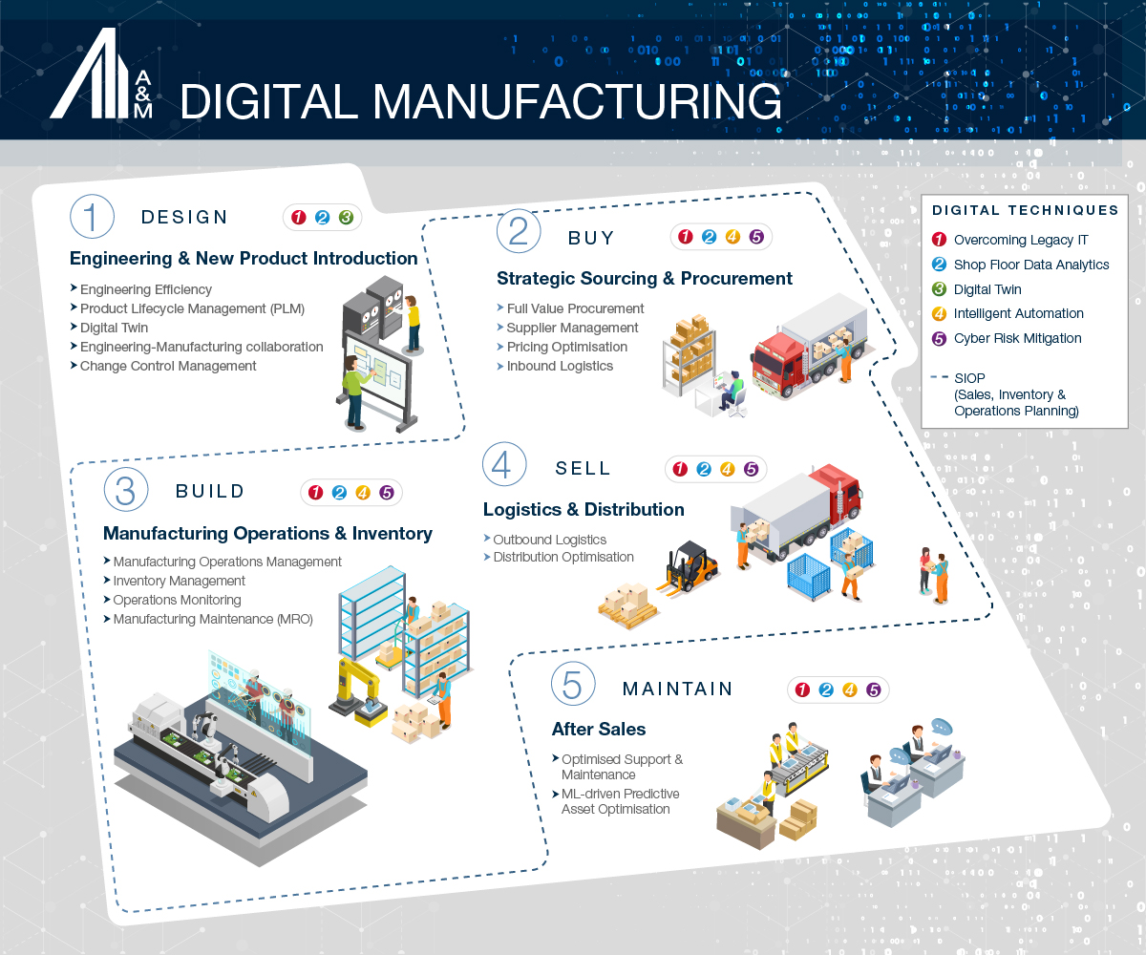
RV College of
Engineering
Road to Industry 4.0
Department of Mechanical Engineering, RV College of Engineering, Bangalore-560059

Slide 35
RV College of
Engineering
Road to Industry 4.0
Molex commissioned Dimensional Research to conduct the survey in June. The independent research firm polled 216 qualified participants in a variety of roles, such as R&D, engineering, manufacturing, strategy, innovation and supply chain management. The goal was to capture data on real-life Industry 4.0 experiences and opinions. Overall, the survey respondents validated the potential benefits of smart manufacturing technologies and the Industrial Internet of Things.
Overall, a significant majority of survey respondents (87 percent) are excited about the transformative power of Industry 4.0 over the next decade. Key findings include:
51 percent report having a well-defined Industry 4.0 corporate strategy with executive sponsorship.
49 percent have already achieved success with these technologies, while 21 percent are still in the investment stage.
More than half expect to meet their Industry 4.0 goals within two years, while a third believe it will take three to five years to reach that milestone.
44 percent find organizational and cultural adoption barriers hardest to overcome.
According to the survey, manufacturers believe that Industry 4.0 technologies will enable them to build better products (69 percent); reduce overall manufacturing costs (58 percent); increase revenues (53 percent); offer products at lower prices (35 percent); and decrease time-to-market (35 percent).
Department of Mechanical Engineering, RV College of Engineering, Bangalore-560059

Slide 36
RV College of
Engineering
Road to Industry 4.0
OVERCOMING CHALLENGES IN LEGACY MANUFACTURING SYSTEMS
Making the move to Industry 4.0 can seem daunting for many manufacturing organisations. It involves moving away from decades-old legacy systems that are not only highly complex but also critical for the day-to-day operations of the business. Reconfiguring, modifying or replacing major applications can be cumbersome and expensive, as well as hugely disruptive to the business operations.
Embrace Robotic Process Automation (RPA) for Efficiency and Improved Data Insights: In a shop floor environment, operators need to periodically collect data for time recording, quality checks or productivity reports, among other compliance and business intelligence needs.
Break Down the Data Silos: In manufacturing and industrial environments with a high dependency on legacy systems, engineers and administrators can spend a significant share of their working hours hunting down information across different databases and systems that are poorly integrated and often isolated from one another.
Adopt Hybrid Cloud to Enable Agile Innovation: Cloud-based computing is a key enabler of Industry 4.0 and 5.0 technologies. However, many manufacturing leaders may be sceptical about moving critical operational data to third-party cloud service providers due to concerns around security, latency or resiliency.
Department of Mechanical Engineering, RV College of Engineering, Bangalore-560059

Slide 37
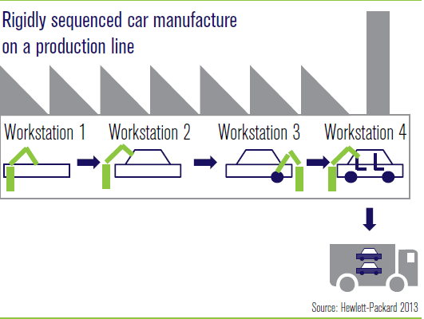
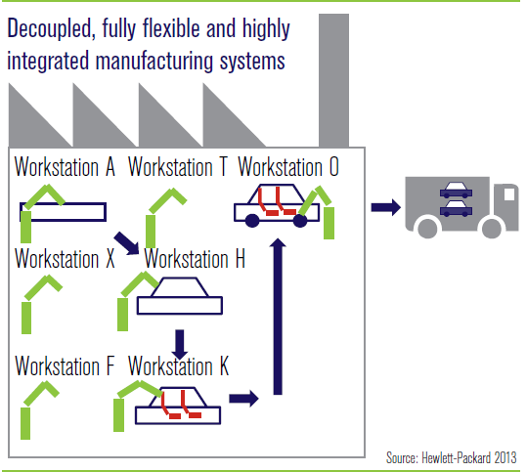
RV College of
Engineering
Todays And Tomorrow Factory
Rigidly sequenced car manufacture on a production line
Decoupled, fully flexible and highly integrated manufacturing system
Department of Mechanical Engineering, RV College of Engineering, Bangalore-560059

Slide 38
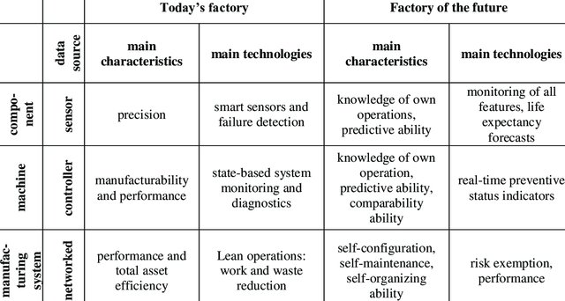
RV College of
Engineering
Todays And Tomorrow Factory
Department of Mechanical Engineering, RV College of Engineering, Bangalore-560059

Slide 39

RV College of
Engineering
Dept. of Mech. Engg., RV College of Engineering, Bangalore-560059

